Slide 1
Simulation of the Half-Car Model

Slide 2
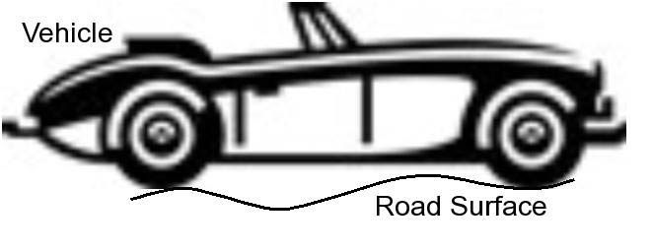

Slide 3
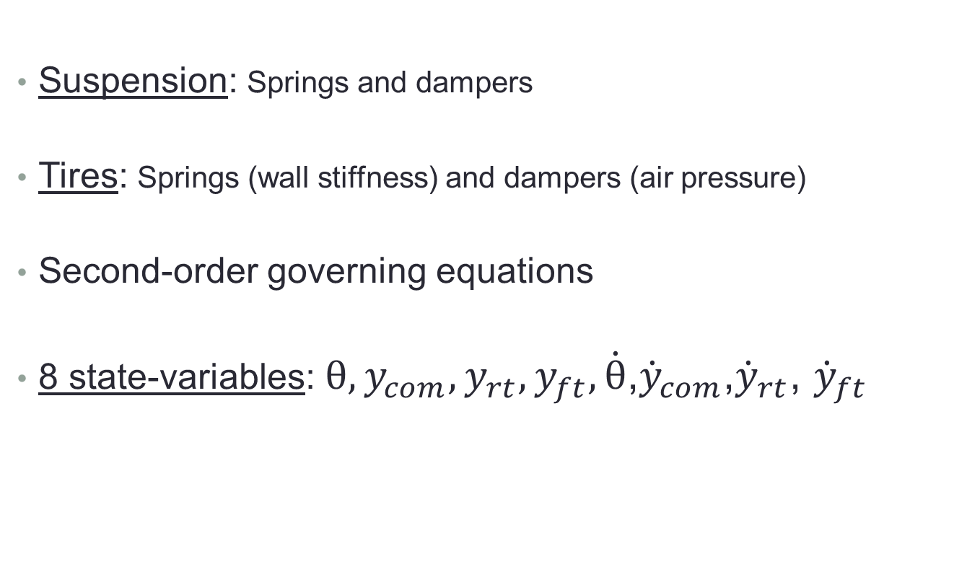
Describing the Half-Car
Suspension: Springs and dampers
Tires: Springs (wall stiffness) and dampers (air pressure)
Second-order governing equations
8 state-variables: $θ, y_{com}, y_{rt}, y_{ft},\dot{θ}$,${\dot{y}}_{com}$,${\dot{y}}_{rt}$, ${\dot{y}}_{ft}$

Slide 4
User Inputs
road surface
spring constants and damper coefficients
free length of all springs
tire masses
car mass
car length
location of center of mass

Slide 5
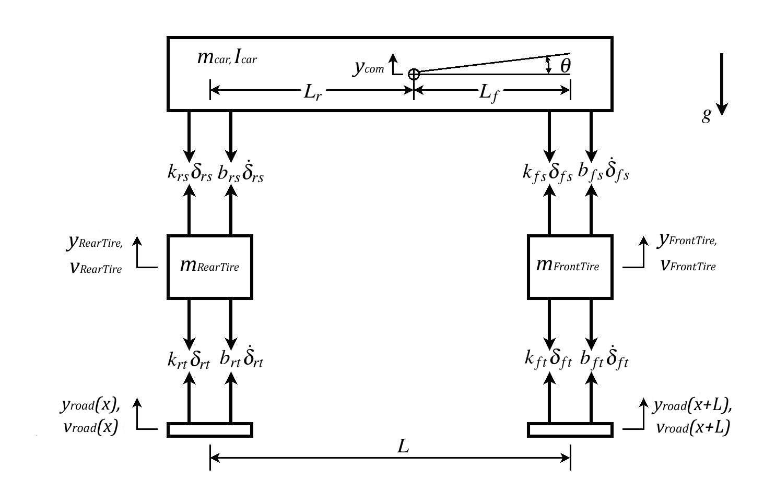
Free Body Diagram

Slide 6
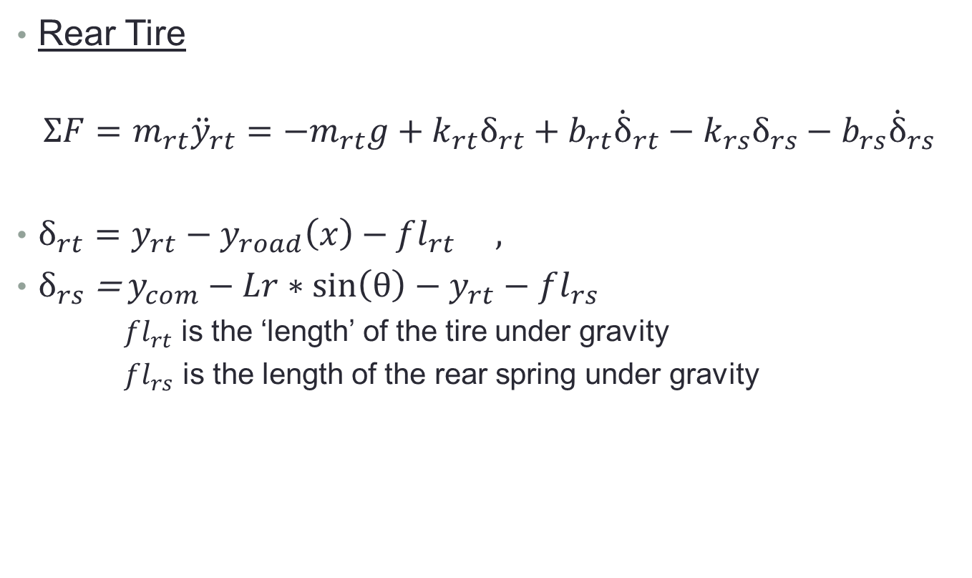
Governing Equations
Rear Tire
$$ΣF=m_{rt}{\ddot{y}}_{rt}=−m_{rt}g+k_{rt}δ_{rt}+b_{rt}{\dot{δ}}_{rt}−k_{rs}δ_{rs}−b_{rs}{\dot{δ}}_{rs}$$
$δ_{rt}=y_{rt}−y_{road}\left(x\right)−fl_{rt} ,$
$δ_{rs}$ = $y_{com}−Lr∗\sin\left(θ\right)−y_{rt}−fl_{rs}$
$fl_{rt}$ is the ‘length’ of the tire under gravity
$fl_{rs}$ is the length of the rear spring under gravity

Slide 7
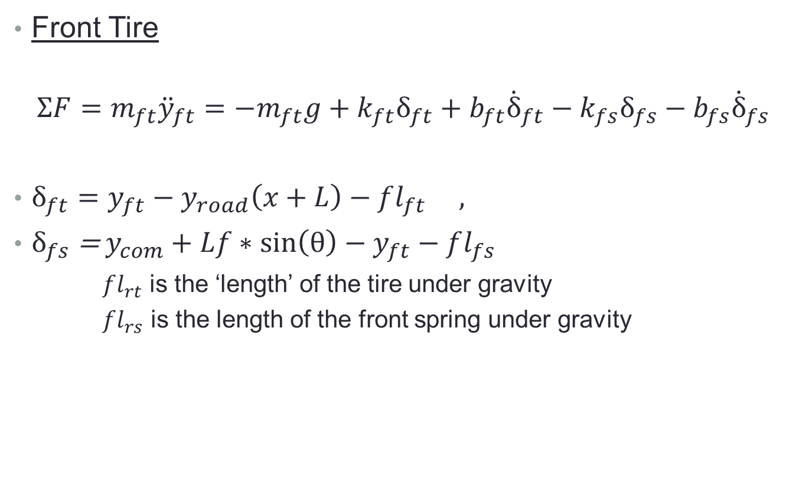
Front Tire
$$ΣF=m_{ft}{\ddot{y}}_{ft}=−m_{ft}g+k_{ft}δ_{ft}+b_{ft}{\dot{δ}}_{ft}−k_{fs}δ_{fs}−b_{fs}{\dot{δ}}_{fs}$$
$δ_{ft}=y_{ft}−y_{road}\left(x+L\right)−fl_{ft} ,$
$δ_{fs}$ = $y_{com}+Lf∗\sin\left(θ\right)−y_{ft}−fl_{fs}$
$fl_{rt}$ is the ‘length’ of the tire under gravity
$fl_{rs}$ is the length of the front spring under gravity

Slide 8

Car Body
$${Στ=I}_{car}\ddot{θ}=\left(−k_{fs}δ_{fs}−b_{fs}{\dot{δ}}_{fs}\right)Lfcos\left(θ\right)+\left(k_{rs}δ_{rs}+b_{rs}{\dot{δ}}_{rs}\right)Lrcos\left(θ\right)$$
$$I_{car}=\frac{1}{3L}\left(LrLf^{2}+LfLr^{2}\right)m_{car}$$
$$ΣF=m_{car}{\ddot{y}}_{com}=−m_{car}g−k_{fs}δ_{fs}−b_{fs}{\dot{δ}}_{fs}−k_{rs}δ_{rs}−b_{rs}{\dot{δ}}_{rs}$$

Slide 9
What’s In the Simulation:
Runge-Kutta4 algorithm solves the equations over discrete time steps
Road and car are plotted over time
Show demonstration

Slide 10
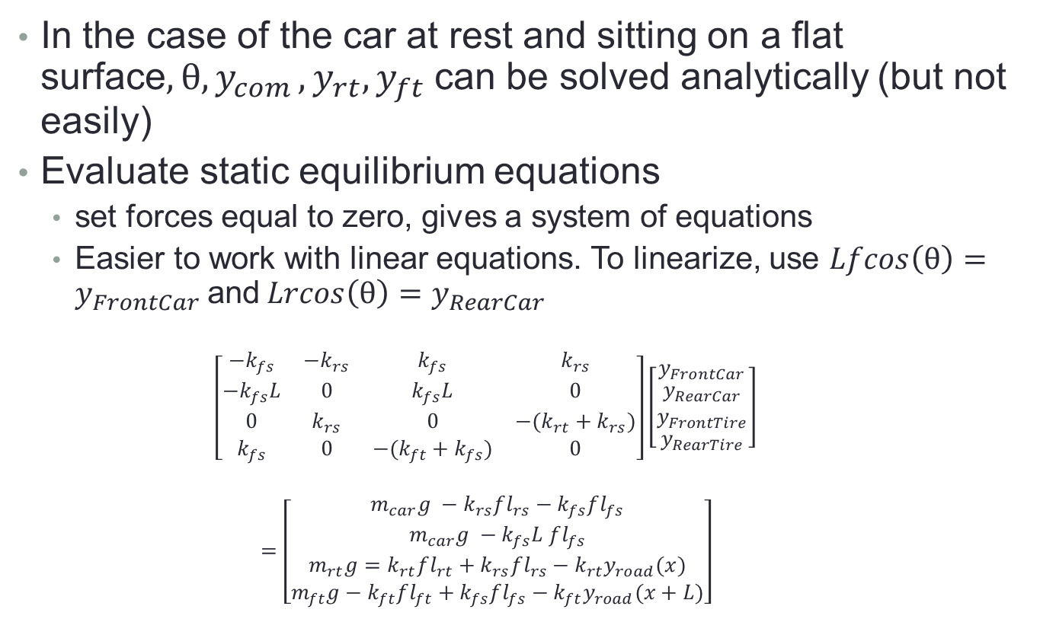
Test Calculation
In the case of the car at rest and sitting on a flat surface${, θ,y}_{com}, y_{rt}, y_{ft}$ can be solved analytically (but not easily)
Evaluate static equilibrium equations
set forces equal to zero, gives a system of equations
Easier to work with linear equations. To linearize, use $Lfcos\left(θ\right)=y_{FrontCar}$and$Lrcos\left(θ\right)=y_{RearCar}$
$$\left[\begin{matrix}−k_{fs} & −k_{rs} & k_{fs} & k_{rs} \\ −k_{fs}L & 0 & k_{fs}L & 0 \\ 0 & k_{rs} & 0 & −(k_{rt}+k_{rs}) \\ k_{fs} & 0 & −(k_{ft}+k_{fs}) & 0\end{matrix}\right]\left[\begin{matrix}y_{FrontCar} \\ \begin{aligned}y_{RearCar} \\ y_{FrontTire}\end{aligned} \\ y_{RearTire}\end{matrix}\right]$$
$$=\left[\begin{matrix}m_{car}g −k_{rs}fl_{rs}−k_{fs}fl_{fs} \\ m_{car}g −k_{fs}L fl_{fs} \\ m_{rt}g=k_{rt}fl_{rt}+k_{rs}fl_{rs}−k_{rt}y_{road}(x) \\ m_{ft}g−k_{ft}fl_{ft}+k_{fs}fl_{fs}−k_{ft}y_{road}(x+L)\end{matrix}\right]$$

Slide 11

Test Calculation
Drop car from height, wait for transient response to decay, observe values of $y_{rt}, y_{ft}, y_{fCar}, y_{rCar}$ and compare to equilibrium values
Test the simulation

Slide 12
References
http://mece.utpa.edu/Kypuros/teaching/mece-4305/notes/VehicleSuspensionModelingNotes.pdf
Dixon, John. The Shock Absorber Handbook.
http://www.library.cmu.edu/ctms/ctms/simulink/examples/susp/suspsim.htm

